Slide 1
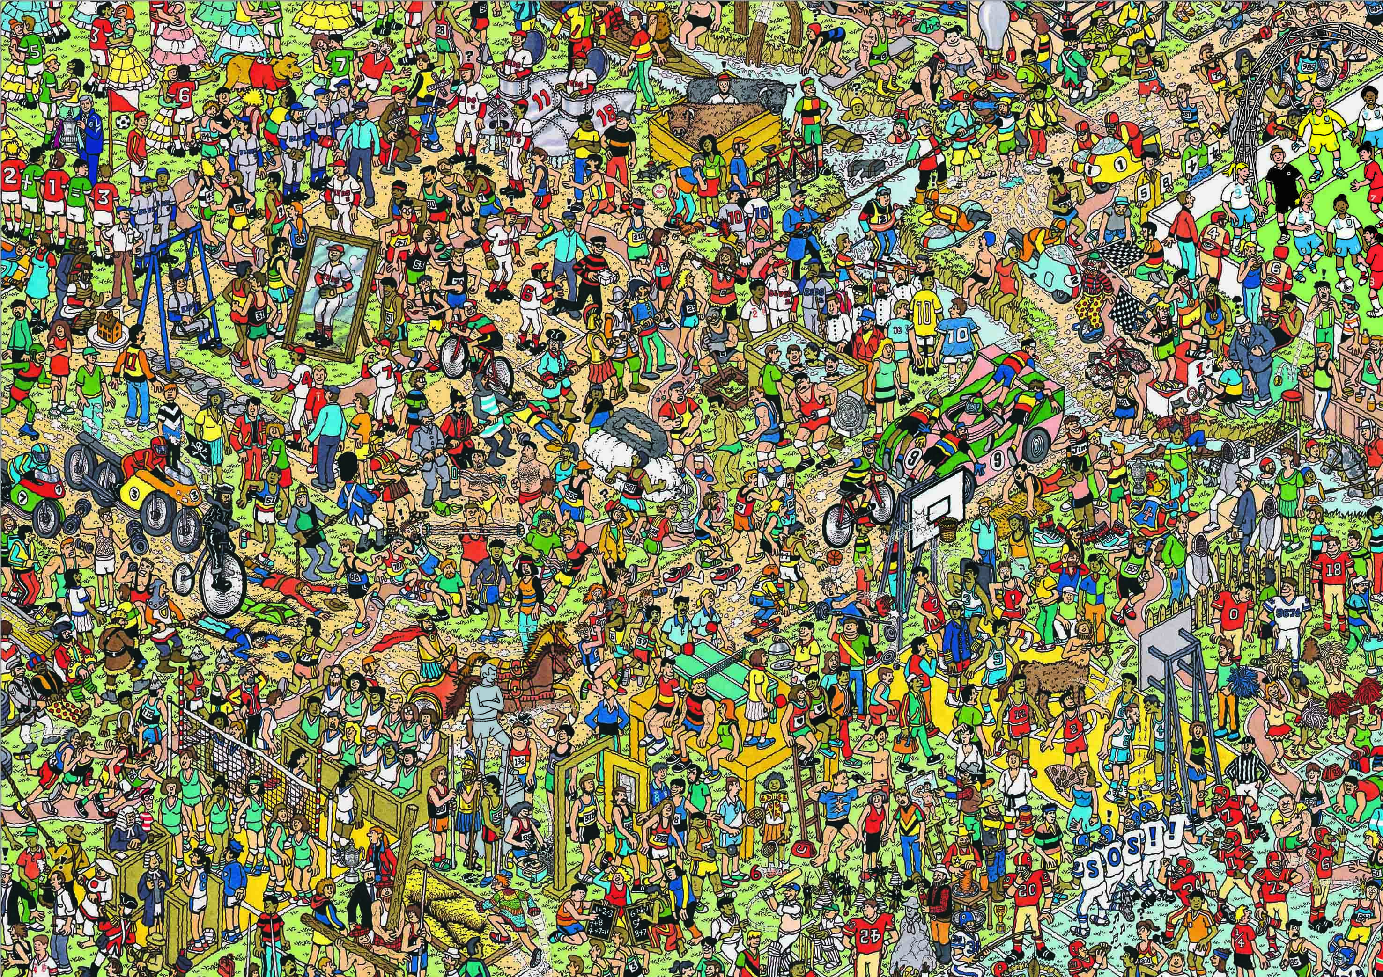
Image Recognition on Busy Images
Mark Edwards
CSU Channel Islands
mark.edwards727@myci.csuci.edu

Slide 2
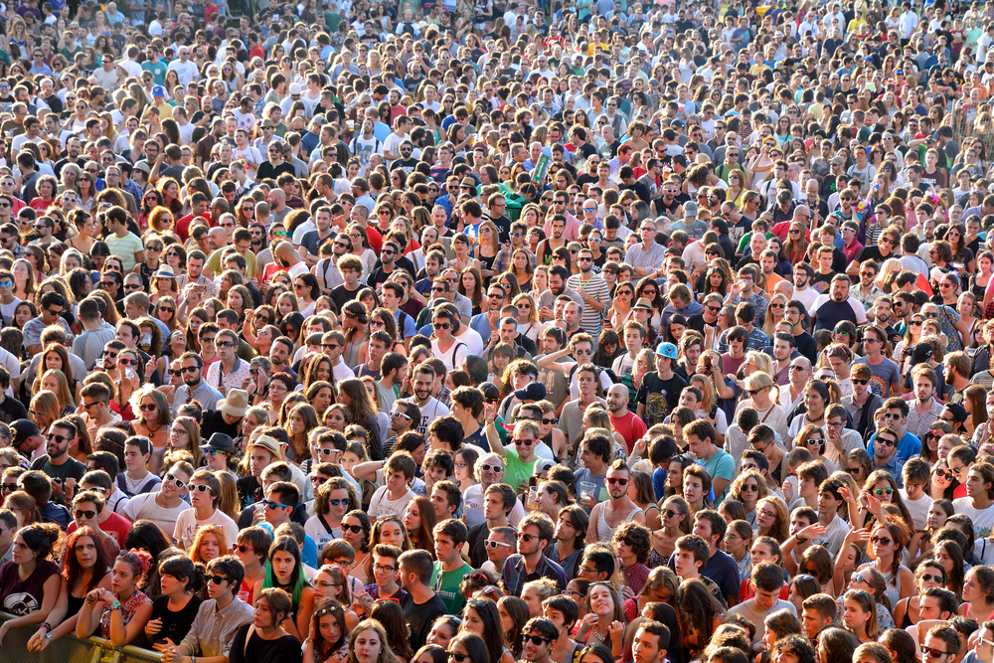
Image Recognition on Busy Images
The task of identifying small patterns within large images
“Where’s Waldo?”
Identifying cars and buildings within aerial photos
Identifying animals from within a landscape photograph

Slide 3
Image Recognition
Template Matching
Machine Learning
Machine Learning “Cascades”
Multiple learning algorithms used together
“Convolutional Neural Networks”

Slide 4
Convolutional Neural Networks
A comparatively new approach to image recognition
Very popular image recognition algorithm
A variant on Multilayer Perceptrons
Optimized for image processing

Slide 5
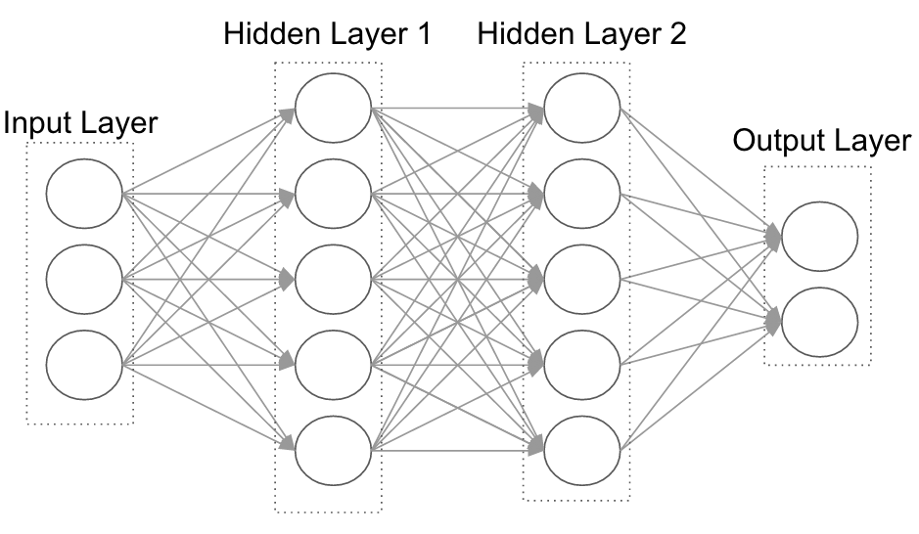
Multilayer Perceptron
Fully Connected

Slide 6
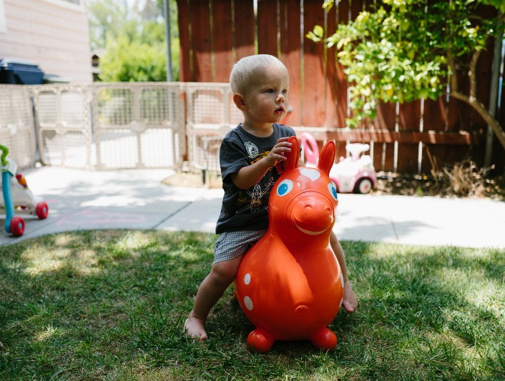
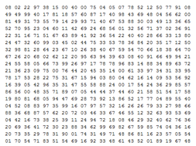
Difference in Perspective
Human Perspective
Computer Perspective

Slide 7
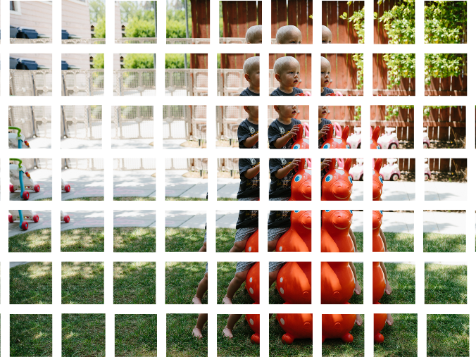
Convolutions
Involve only a small part of an image

Slide 8
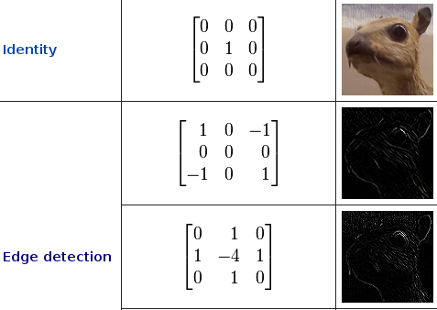
Convolutions
Local operations that extract information about the image

Slide 9
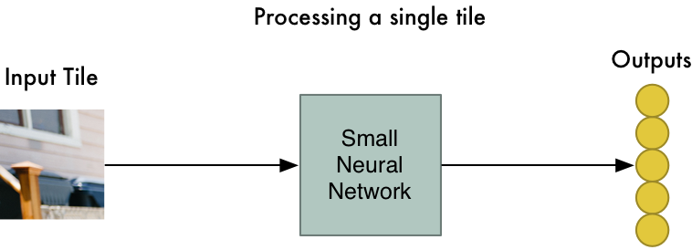
Convolutions
Generated using small neural networks

Slide 10
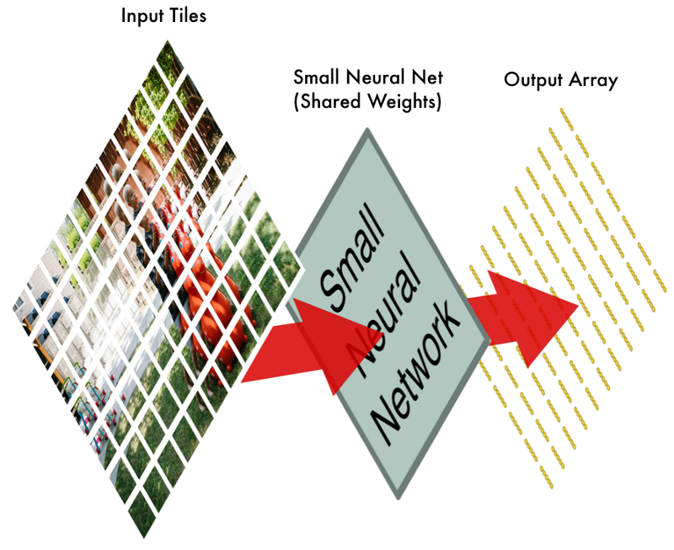
Convolutions
The learned convolutions are applied across the entire image

Slide 11
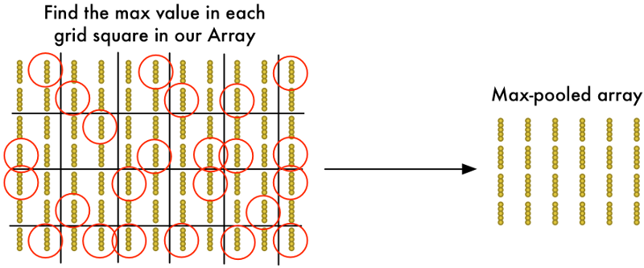
Pooling
Subsampling reduces the number of neurons

Slide 12
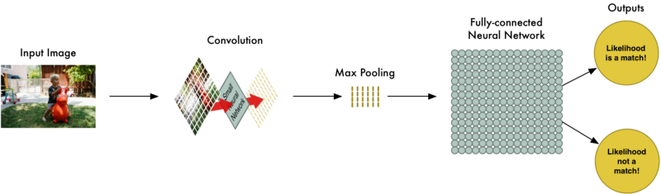
Convolutional Neural Network
Output
Fully Connected
Input
Convolution
(Max) Pooling

Slide 13
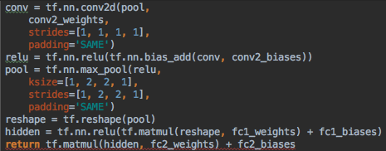
Sample Code

Slide 14
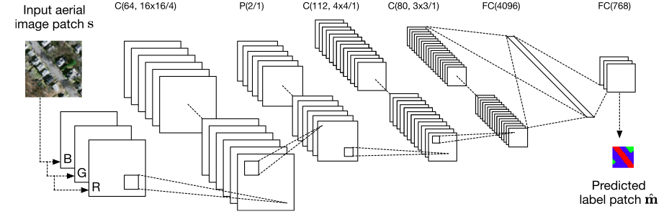
Convolutional Model
Developed by multiple research teams
_{[1], [3]}

Slide 15
Training
Trained on the Vehicle Detection in Aerial Imagery dataset using only RGB color images _{[2]}
Trained using 10 fold cross validation
Currently only locates objects within 1/32 areas of the input image (due to computational limitations)
Training is based on the center of the detected object.

Slide 16
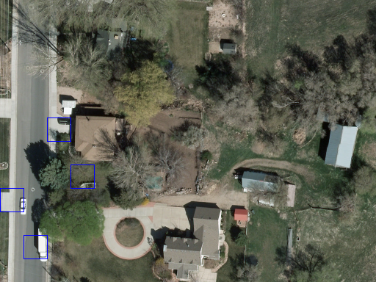
Sample Output

Slide 17
Questions?

Slide 18
Bibliography
Mnih, Volodymyr. Machine Learning for Aerial Image Labeling. Master's thesis, Thesis / Dissertation ETD, 2013. 6-33.
Razakarivony, Sebastien, and Frederic Jurie. "Vehicle Detection in Aerial Imagery." Journal of Visual Communication and Image Representation. https://downloads.greyc.fr/vedai/.
Saito, Shunta, Takayoshi Yamashita, and Yoshimitsu Aoki. "Multiple Object Extraction from Aerial Imagery with Convolutional Neural Networks." Journal of Imaging Science and Technology, January 2016.

